Slide 1

Exploratory Data Analysis
< G2M INSIGHT FOR CABS INVESTMENT FIRM CASE STUDY >
<21ST March, 2023>

Slide 2

Agenda
Executive Summary
Problem Statement
Approach
EDA
EDA Summary
Recommendations

Slide 3
Executive Summary
XYZ is a private firm in US. Due to remarkable growth in the Cab Industry in last few years and multiple key players in the market, it is planning for an investment in Cab industry and as per their Go-to-Market(G2M) strategy they want to understand the market before taking final decision.

Slide 4
Problem Statement
To prepare actionable insights that will help XYZ firm identify the right company for making investment.

Slide 5
Exploratory Data Analysis (EDA)
Approach:
Data Exploration: Merging and understanding final data set
Forecasting based on profit merging using different graphs
Recommendation based on the best output

Slide 6
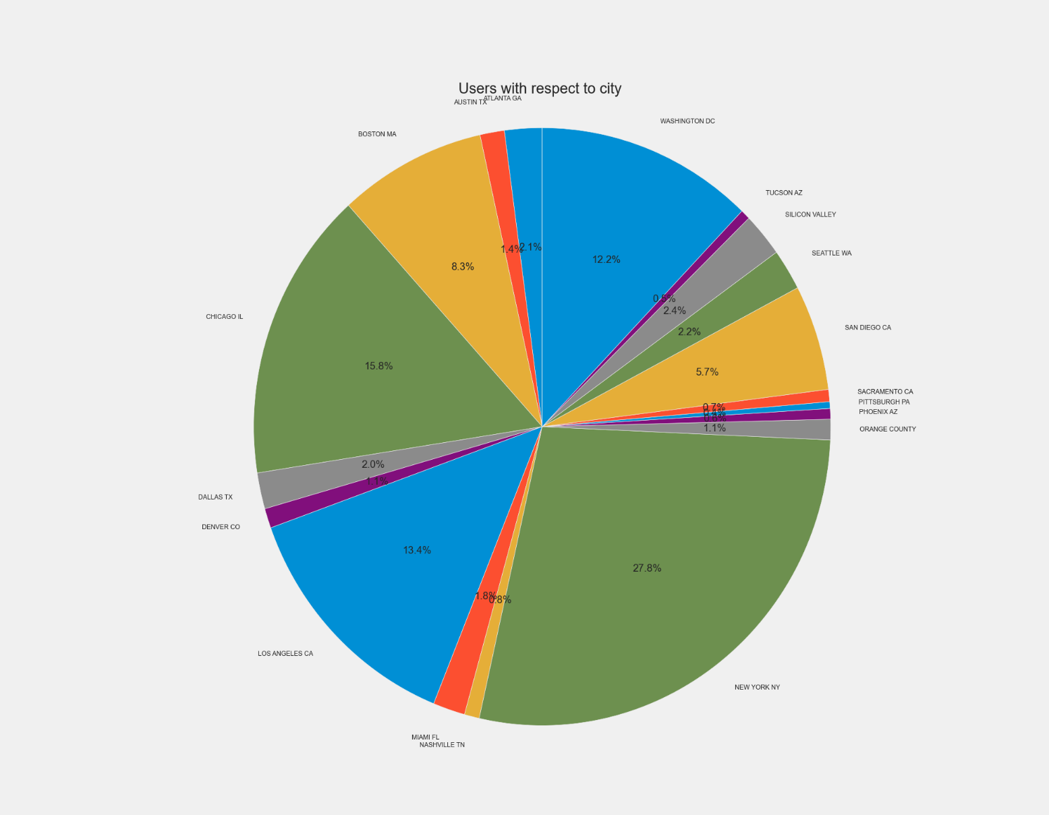
Exploratory Data Analysis (EDA)
Comparing the number of users per city
New York has the highest population of users (27%) while Pittsburgh PA has the lowest number of users with 0.4% users.

Slide 7
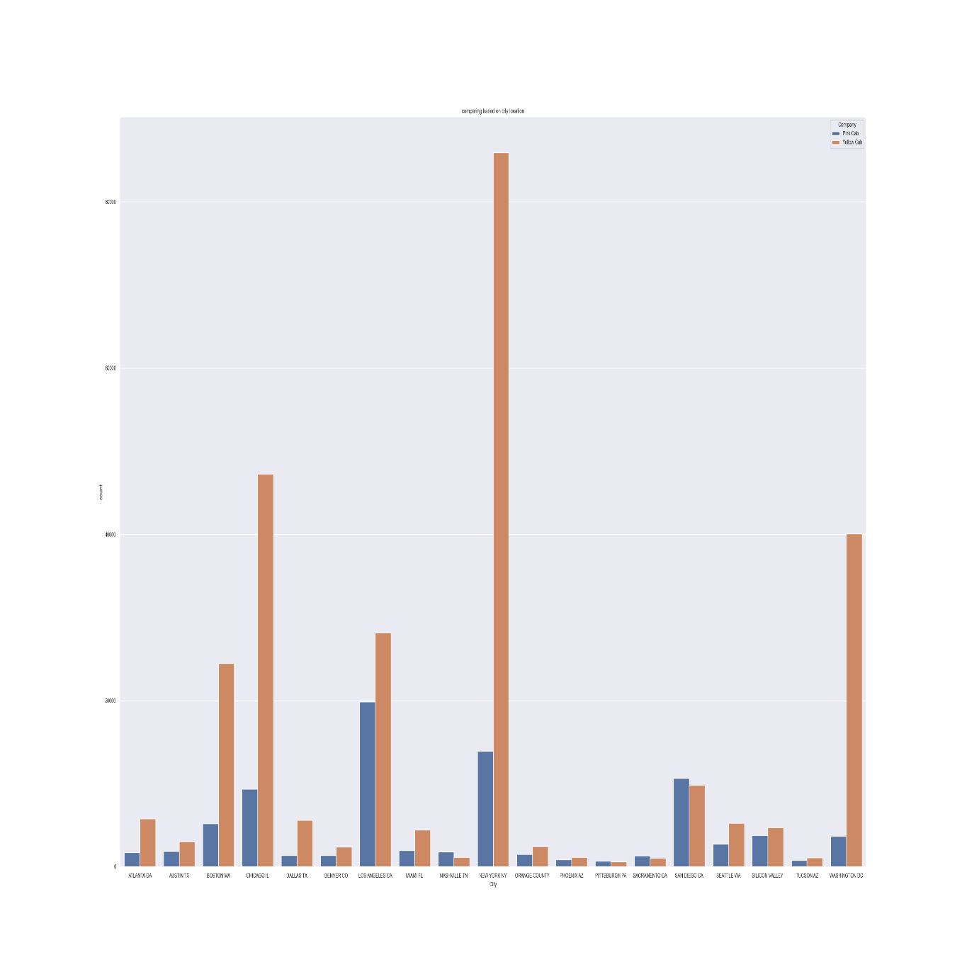
Exploratory Data Analysis (EDA)
Comparing the number of users of a cab firm per city
Yellow cab has more customers/users in majority of the cities

Slide 8
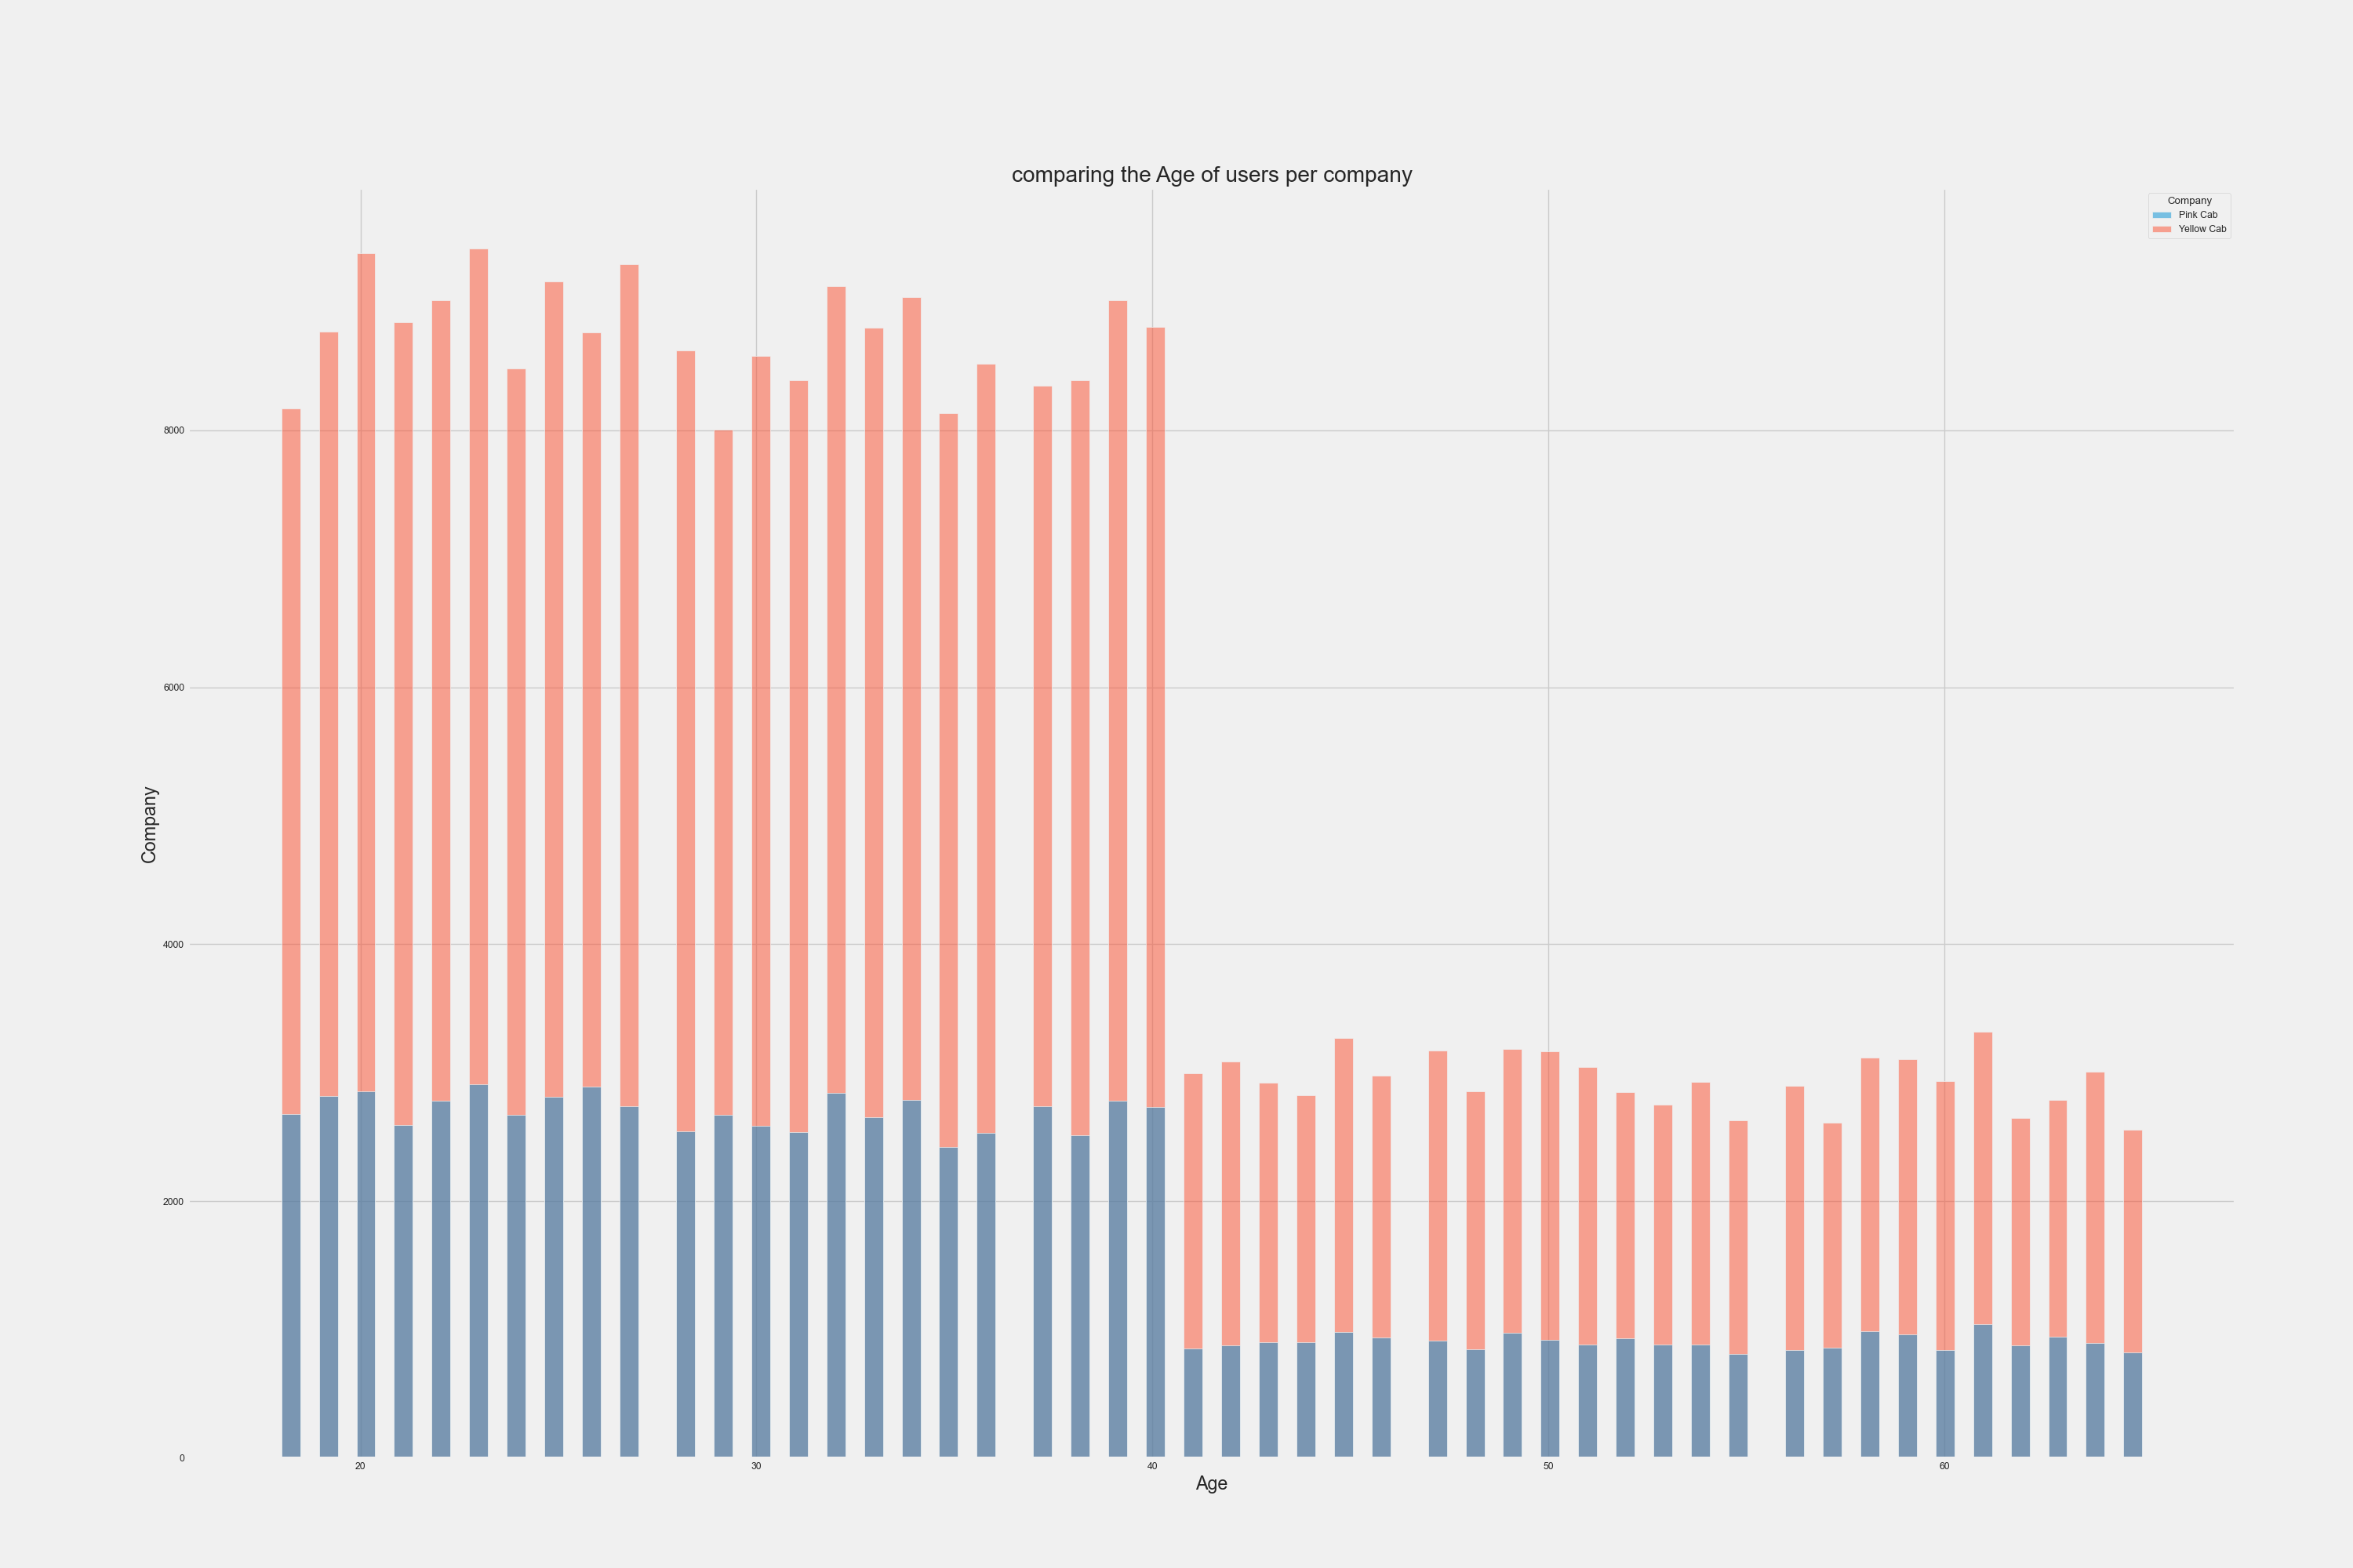
Exploratory Data Analysis (EDA)
Comparing the age of users of each cab company
Yellow cab has more customers in the middle age and lower age.

Slide 9
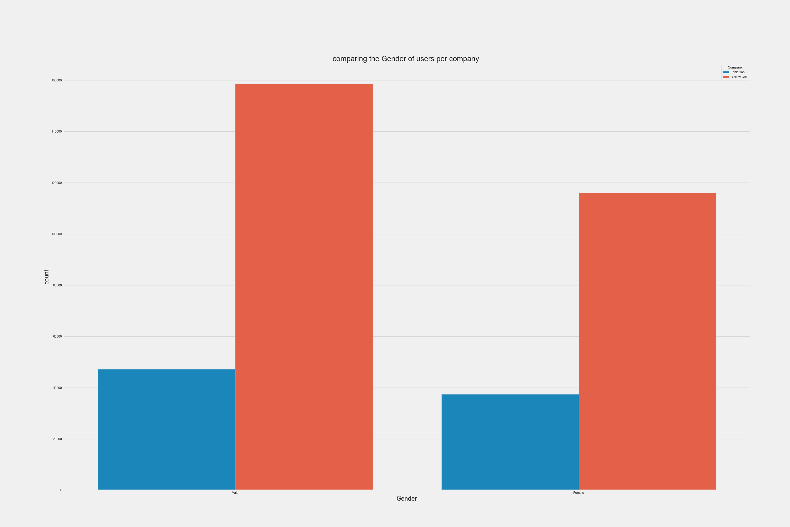
Exploratory Data Analysis (EDA)
Comparing the gender of users of each cab company
Yellow cab has more active customers for both genders.

Slide 10
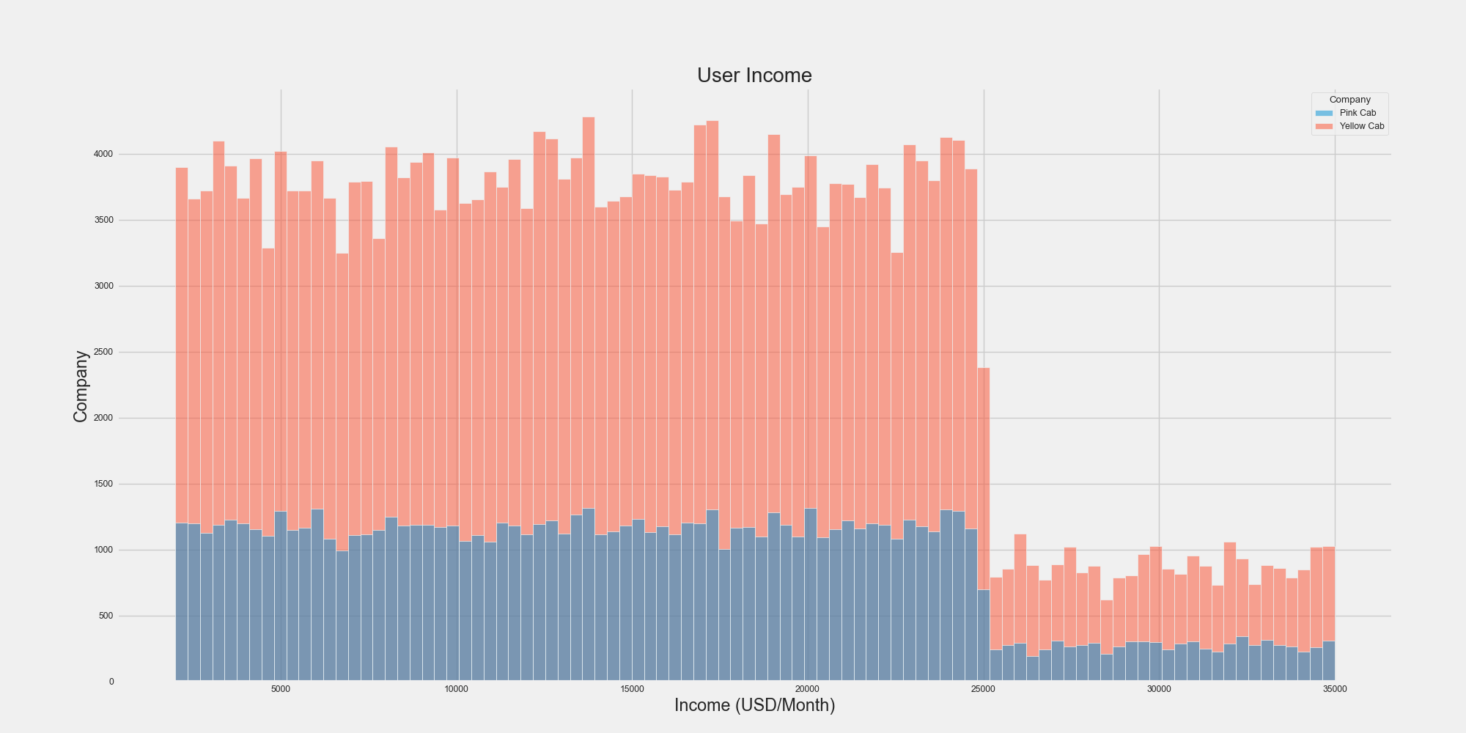
Exploratory Data Analysis (EDA)
Comparing the Income (USD/Month) of users of each cab company
Yellow cab customers have more income than the Pink cab customer

Slide 11
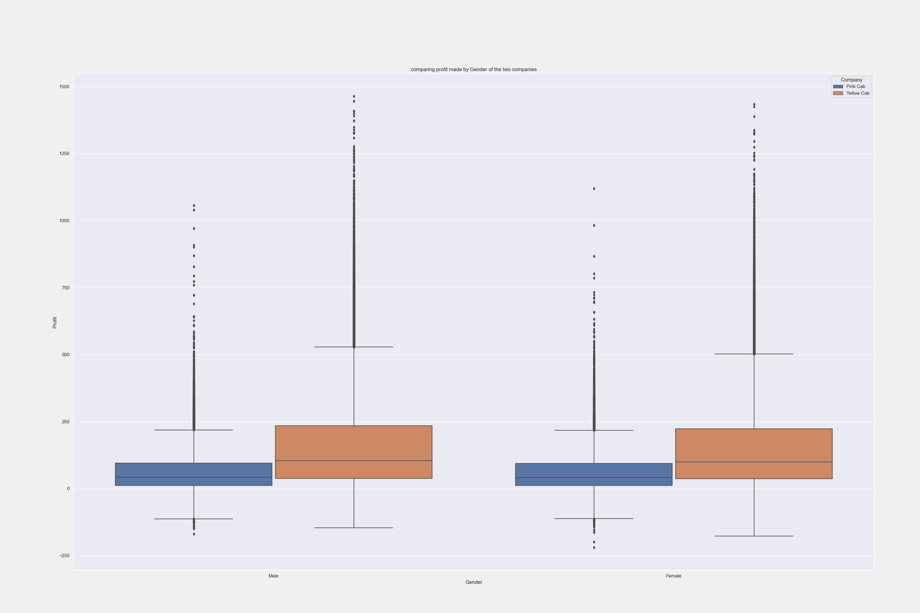
Exploratory Data Analysis (EDA)
Comparing profit made by gender in each firm
Profit made by the genders of the Yellow cab is more than that of Pink cab

Slide 12
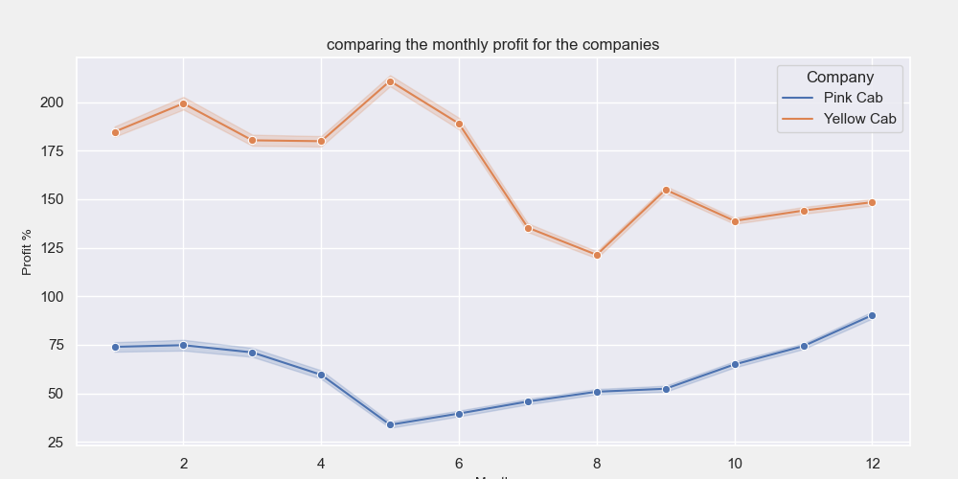
Exploratory Data Analysis (EDA)
Comparing the monthly profits made by the firms
Yellow cab firm makes more monthly profit especially in the mid-year

Slide 13
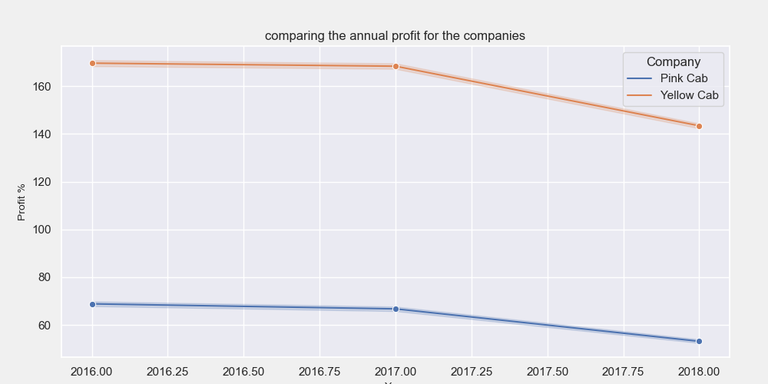
Exploratory Data Analysis (EDA)
Comparing the annual profits made by the firms
Based on the plot of Annual profit, Yellow firm performs better than Pink firm

Slide 14
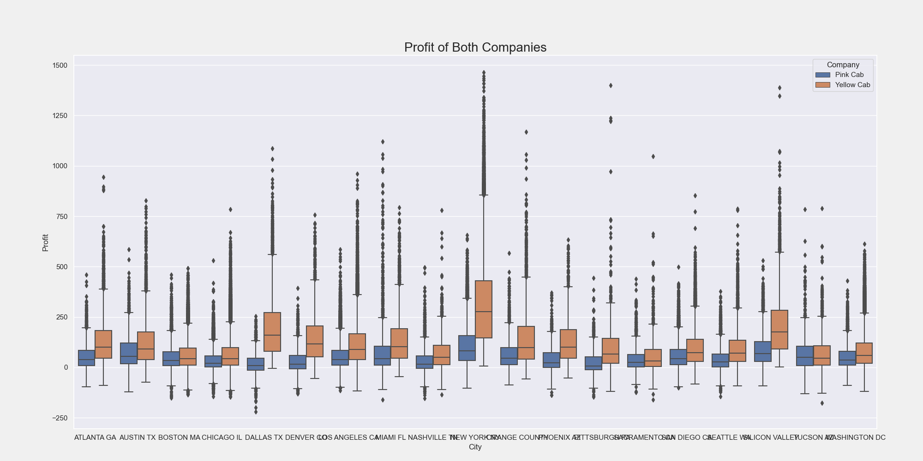
Exploratory Data Analysis (EDA)
Comparing the profits made by the firms in each city
Looking at the profit made in each city by the two cab firms, Yellow firm has done better in 99% of the cities.

Slide 15
EDA Summary
Recommendation:
After evaluating the two firms on the above points, it was discovered that the Yellow cab firm was more profitable than the Pink cab firm.
Yellow cab firm has more customer across all age groups when compared to Pink cab.
Based on income (USD/Month), Yellow cab is performing better than the Pink cab
Yellow cab makes more annual profit when compared to Pink cab.
Yellow cab has more customer base than the pink cab.
Based on the above points we would recommend that XYZ limited invest in the Yellow cab firm considering the profitability level and volume of users in those cities.

Slide 16
Thank You

